Slide 1
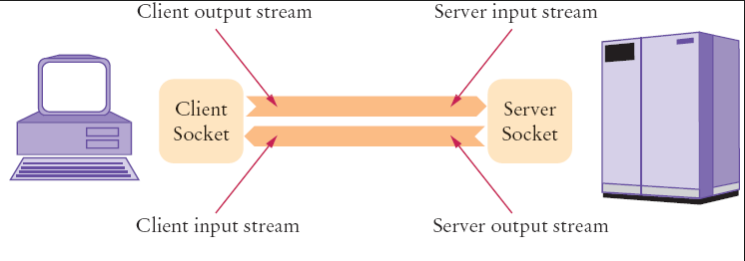
Java Socket Programming
Java Socket programming is used for communication between the applications running on different JRE.
Java Socket programming can be connection-oriented or connection-less.
Socket and ServerSocket classes are used for connection-oriented socket programming.
DatagramSocket and DatagramPacket classes are used for connection-less socket programming.
The client in socket programming must know two information:
IP Address of Server, and
Port number.

